Slide 1

SpeakSense – Final Project Presentation
CSCI 6364 – Machine Learning
Abde Manaaf Ghadiali – G29583342
Gehna Ahuja – G35741419
Venkatesh Shanmugam – G27887303

Slide 2

Project Objective and Data Sources
The objective of this project was to develop a robust and accurate system capable of detecting the language spoken in audio recordings.
By leveraging advanced machine learning and deep learning algorithms and signal processing techniques, the system aims to accurately identify the language spoken in various audio inputs, spanning diverse accents, dialects, and environmental conditions.
This language detection solution seeks to provide practical applications in speech recognition, transcription, translation, and other fields requiring language-specific processing, thereby enhancing accessibility and usability across linguistic boundaries.
In sourcing data, we aim to gather diverse and representative datasets that encompass a wide range of languages, accents, dialects, and speaking styles. We shall be using data sets taken from Kaggle.
Audio Dataset with 10 Indian Languages (kaggle.com) - Bengali, Gujarati, Hindi, Kannada, Malayalam, Marathi, Punjabi, Tamil, Telugu, Urdu
Spoken Language Identification (kaggle.com) - English, Spanish and German.
As a Test (Holdout) Set we have collected Audio from our Friends, Family and Faculty to Demonstrate Live Prediction.
Due to compute restrictions, we shall be using 120,000 audio file for DNN and classical ML, 12,000 audio files for CNN models.

Slide 3
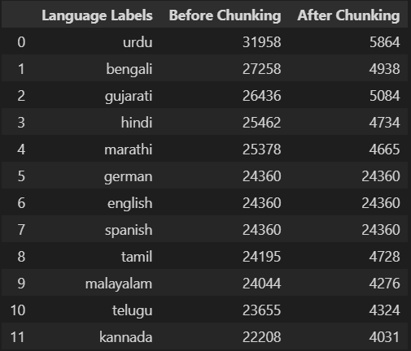
Exploratory Data Analysis (EDA)
Exploratory Data Analysis (EDA) is a statistical approach used to analyze and visualize data sets to understand their main characteristics, uncover patterns, and identify potential relationships between variables.
While going through a few samples of audio files we noticed that the samples from Punjabi language were not correct. They were Gujrati Audio Files. This led us to go through more audio files from the Punjabi folder and conclude that the audio files in the Punjabi folder were wrongly labeled, as all were Gujarati audio files. This was also confirmed when we trained a simple DNN on the Indian Languages data and found that half of the Punjabi audio were predicted as Gujarati.
Now while looking at the Indian Languages Audio Files, we notices that the audio files were of different durations. So, to not create any bias on time duration of audio files, we combined each language audio files into one file and chunked that file to 10 seconds duration audio files. (Note: Due to resource restrictions, we were not able to combine all audio files, hence we only combined audios which were 5 seconds or longer).
Finally, we used 4000 audio files per language (for Feature Vector Approach), 1000 audio files per language (for Feature Matrix Approach) and 200 Spectrogram Images per language (for Image Classification approach) for our model training which were all 10 seconds duration and with a sample rate of 22050 hertz.

Slide 4
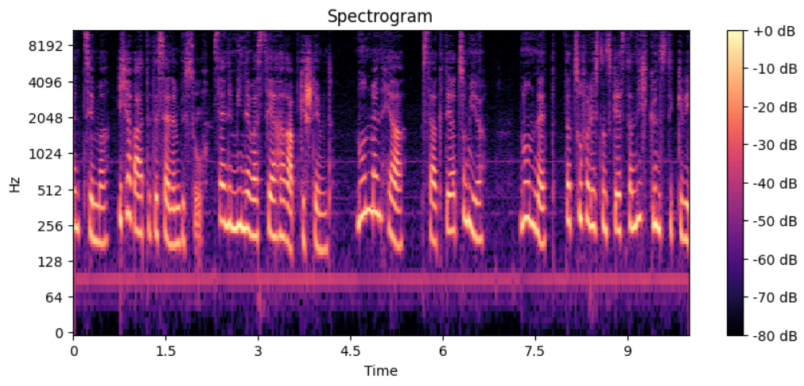
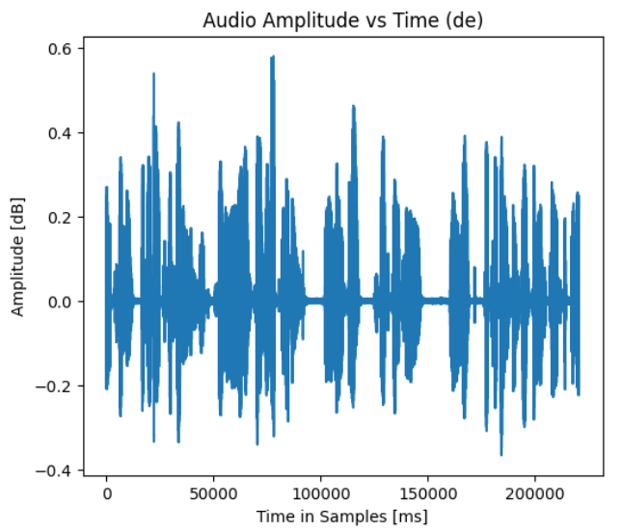
Exploratory Data Analysis (EDA)
Other EDA techniques employed (all present in our Notebooks present on our GitHub):
Going in the folders and listening to audio files (in Jupyter of course).
Visualizing Amplitude (Waveform) plots.
Looking at Spectrogram Plots.
Descriptive Statistics of Audio Duration, Sample Rates and File Sizes.
Mel-frequency Cepstral Coefficients (MFCCs), Energy Distribution, Pitch Analysis, Temporal Features and Frequency Domain Analysis along with their graphs.
Audio Segmentation for silence detection, change in energy or spectral characteristics.
Clustering and Dimensionality Reduction.
Time-Frequency Decomposition.

Slide 5
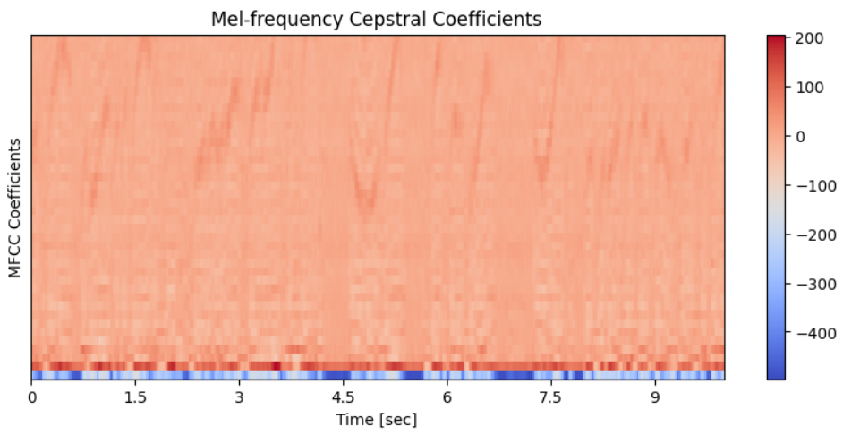
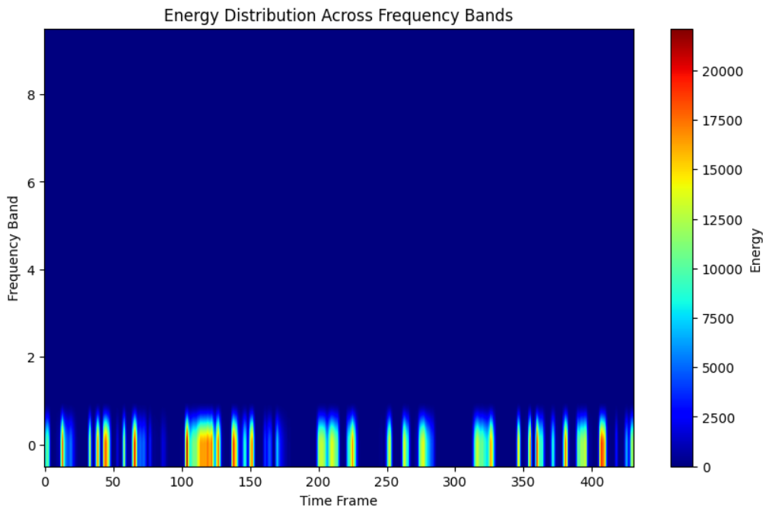
Feature Engineering and Data Transformation
MFCC (Mel-Frequency Cepstral Coefficients) are spectral features extracted from audio signals. They capture frequency characteristics aligned with human perception and vocal tract properties. Along with MFCC features we are also calculating other audio related features such as: Zero Crossing Rate, Spectral Roll-Off, Onset Strength, RMS, Spectral Entropy, Chroma STFT, Pitch.
(Note: The code and Description for all are present in the Jupyter notebook provided).
We are using two forms of the extracted Features:
The Feature Matrix represents a set of features computed from audio frames. Each row in the matrix corresponds to a different frame of the audio signal, and each column represents a different features (final shape of each audio file (431 frames, 58 features)).
The Feature Vector, averages the coefficients across each feature, effectively summarizing the spectral characteristics of the audio signal over time. It's commonly used to obtain a single set of features that represents the entire audio file or segment (gives us 58 feature for each audio file).
We have used two sets of datasets. One is Un-Scaled Raw data (MFCC Features and its Mean) and the other is Scaled version of the same using StandardScaler from Scikit-Learn Library.
We also tried using Noise Removal techniques on our dataset and ran a simple Neural Network, but it resulted in lower accuracy on validation data.

Slide 6
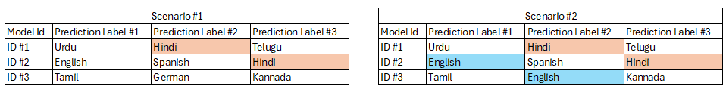
Model Architecture and Training
We have used five methodologies for model training:
Classical ML on Feature Vector: This approach utilizes classical machine learning algorithms, such as Support Vector Machines (SVM), Random Forests, or Gradient Boosting Machines, trained on the mean values of features extracted from audio signals.
DNN model on Feature Vector: This involves training a Deep Neural Network (DNN) on the mean values of audio features extracted from audio signals.
CNN model on Feature Matrix: This involves training a Convolutional Neural Network (CNN) on the feature matrix extracted from audio signals.
CNN model on Spectrogram Images: In this approach, a CNN is trained on spectrogram images generated from audio signals.
Ensembling Techniques: Ensembling techniques involve combining predictions from multiple individual models to improve overall performance. For this project we have taken a different approach to combine the predictions from different models to get the final predictions.
Approach 1: Taking top three predictions from the models and getting the combined probabilities for each label.
Approach 2: Taking the Hadamard Product of all the probabilities across models and then getting the argmax for the label prediction.

Slide 7
Model Evaluation (Classical ML)
Below is the Evaluation metric table for Classical ML Algorithms.
Model Name | Data Type | Train Accuracy | Test Accuracy | Test ROC_AUC
Random Forest | Unscaled | 1.0 | 0.079 | 0.4689
Gradient Boosting | Unscaled | 0.84 | 0.044 | 0.4666
SVC | Unscaled | 0.48 | 0.028 | 0.4467
Random Forest | Scaled | 0.99 | 0.079 | 0.4760
Gradient Boosting | Scaled | 0.84 | 0.045 | 0.4663
SVC | Scaled | 0.99 | 0.080 | 0.4639

Slide 8
Model Evaluation (Deep Learning)
Below is the Evaluation metric table for Deep learning Algorithms.
Model Name | Data Type | Train Accuracy | Train Loss | Test Accuracy | Test Loss | Test ROC_AUC
Dense Neural Network (Feature Vector) | Un-Scaled | 0.968 | 0.105 | 0.964 | 0.121 | 0.980
Convolutional Neural Network (Feature matrix) | Un-Scaled | 0.774 | 0.630 | 0.743 | 0.874 | 0.860
Convolutional Neural Network (Spectrogram) | Raw | 0.086 | 544.4 | 0.060 | 580.5 | 0.498
Dense Neural Network (Feature Vector) | Scaled | 0.999 | 0.002 | 0.993 | 0.018 | 0.996
Convolutional Neural Network (Feature matrix) | Scaled | 0.990 | 0.038 | 0.890 | 0.763 | 0.940

Slide 9
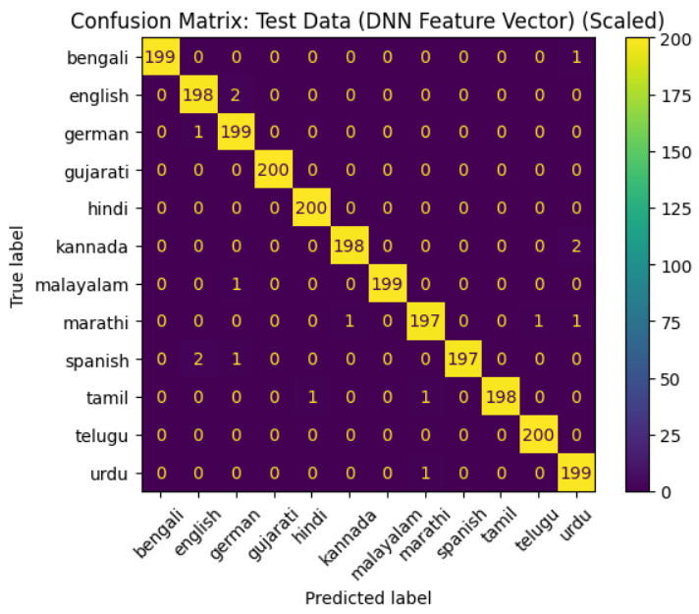
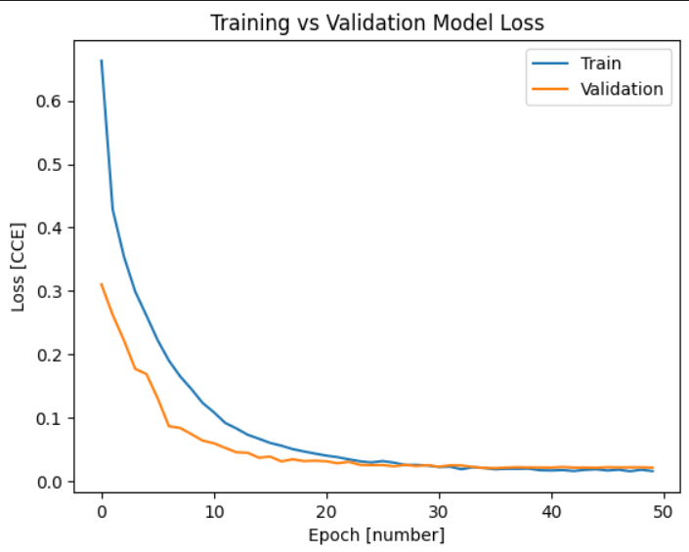
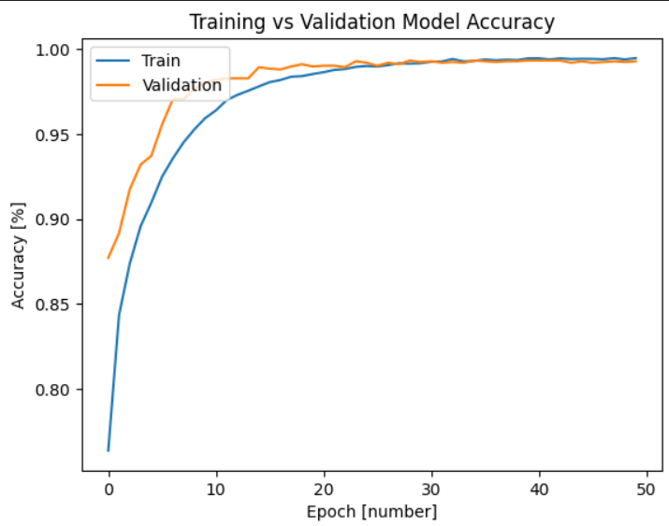
Training vs Validation Confusion Matrix and Graph

Slide 10
Model Evaluation on Recorded Samples
Model Name | Data Type | Test Accuracy
Dense Neural Network (Feature Vector) | Un-Scaled | 0.619
Convolutional Neural Network (Feature matrix) | Un-Scaled | 0.619
Dense Neural Network (Feature Vector) | Scaled | 0.381
Convolutional Neural Network (Feature matrix) | Scaled | 0.476
Ensembling Approach #1 | Combined | 0.619
Ensembling Approach #2 | Combined | 0.619
Below is the Evaluation metric table on the best of our models. We asked our family and friends to record some audios for testing our models.

Slide 11

Thank You! Meme Time
Number of times we had to re-install the environment – 6 (2 per group member)
Number of times our System or Editor crashed – 10s
Number of times our code stopped working unnecessarily (It was working a minute ago) – Somewhere in 100s
Number of WTFs per code cell execution - ∞

Slide 12

References
"Language Identification from Speech" by Douglas Reynolds, Thomas Quatieri, and Robert Dunn. This paper provides an overview of techniques and challenges in language identification using speech signals.
"Deep Learning Approaches for Language Identification in Short Utterances" by Alan McCree and Andreas Stolcke. This study explores the application of deep learning methods, specifically convolutional and recurrent neural networks, for language identification tasks.
"Multilingual Speech Recognition with a Single End-to-End Model" by Tara N. Sainath et al. This paper discusses approaches to multilingual speech recognition, which may provide insights applicable to language detection from audio.
"Language Identification and Speech Recognition" by John Dines et al. This book chapter covers various methods and algorithms for language identification and speech recognition, offering a comprehensive overview of the field.
"Automatic Language Identification: A Survey of the State of the Art" by Osman U. Uzuner and V. Zeynep F. Ozbay. This survey paper discusses different approaches to automatic language identification, including acoustic, phonetic, and linguistic methods.

